Slide 1




COMPARISON some of the world’s most FASCINATING BUILDING
Presented by

Slide 2
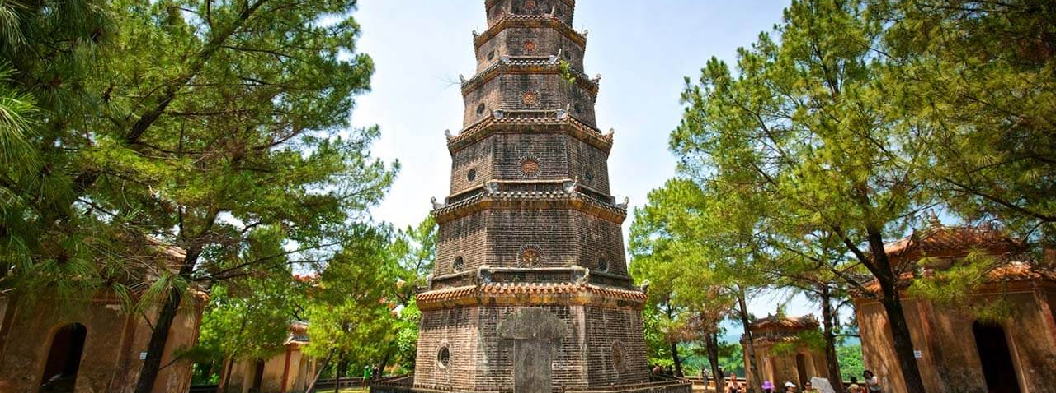
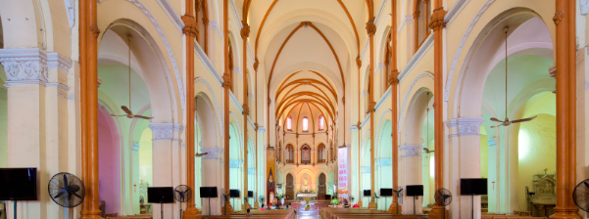
Thien Mu Pagoda
01
Notre-Dam Cathedral
02
The Imperial Citadel of Hue
03
The Imperial Citadel of Thang Long
04

Slide 3
DIFFERENCES
Thien Mu Pagoda
Notre-Dam Cathedral

Slide 4
Thien Mu Pagoda
Notre-Dam Cathedral.
Was built in 1884
the dynasty of Lord Nguyen Hoang , prosperous development of buddhism
On a small hill overlooking Huong river
Height
Locate
The lower floor is large ,
the higher tower wall narrow
21m high octagonal tower- 8 sides with 7 storeys
Purpose
Height
honoring buddhism and creating a place to worship buddha

Slide 5
Notre-Dam Cathedral.
Thien Mu Pagoda
Years
started 1863 and competed in 1880
by the French colonist’s era
Locate
The heart of HCM city
Height
A length of 93 meters ,
A width of 325 meters
A height ~ 21 meters
Agch
built with stunning red brick façade ,
spires mixed to european and vietnamese influences
Purpose
to provide a place of worship for the French Catholic community in Saigon.

Slide 6
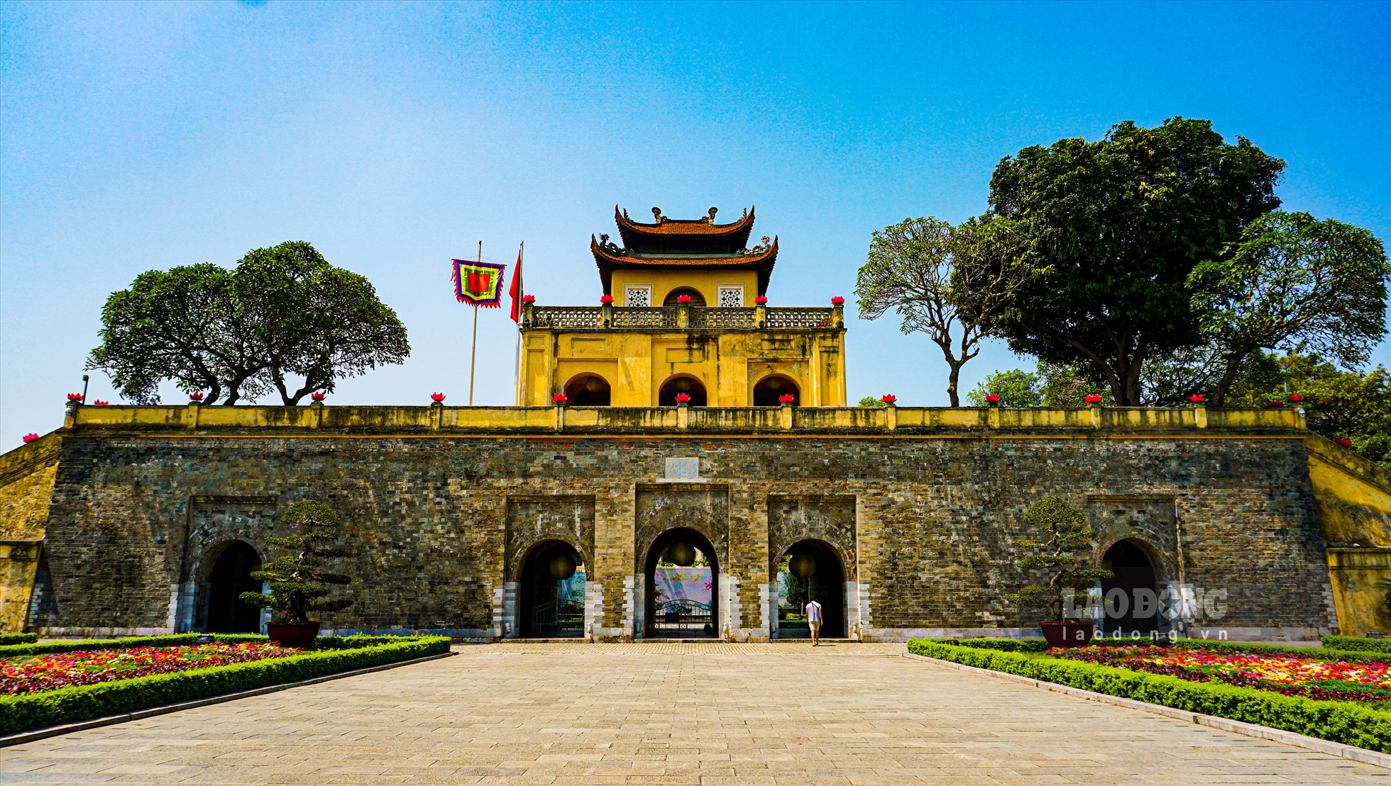
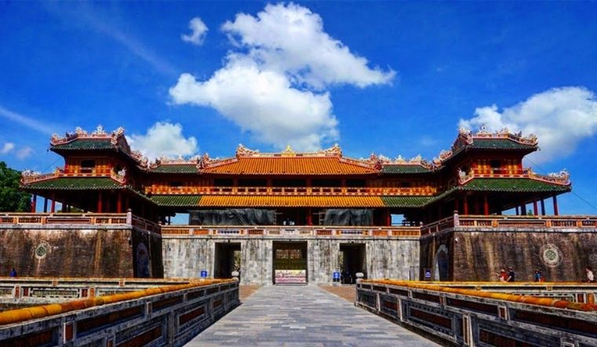
DIFFERENCES
Imperial Citadel of Thang Long
Imperial Citadel of Hue

Slide 7
DIFFERENCES
Imperial Citadel of Thang Long
Imperial Citadel of Hue
Constructed in the 11 centuries
constructed in the 19 centuries
Built and ruled by the Nguyen ancestry
The castle was built under the reign of Emperor Ly Thai To of the Ly dynasty.
Placed in Huế
Placed in Hanoi

Slide 8

SAME FEATURE

Slide 9
SAME FEATURE
PURPOSE
LAYERS
VALUES
To protect the kings and his clan, create an economic center
The wall, Hoang Thanh, Tu Cam Thanh
Admitted as a world heritage site by the UNESCO

Slide 10
Imperial Citadel of Hue
Built from 1802-1834
Has more than 100 small building
Has many cultural values such as Nhã Nhạc Cung Đình

Slide 11

THANK YOU!!

